Slide 1

Testbed Automation for Network Security and Security Analytics
Aragats Amirkhanyan
Internet-Technologies and Systems
Hasso Plattner Institute

Slide 2
Motivation
Common issues for research in network security and security analytics areas:
Data
Test network environment
Testbed

Slide 3
Agenda
Motivation
A testbed for preparing data to analytics
Architecture
User behavior - Normal scenario
User behavior - Abnormal scenario
Implementation
Results
Conclusion

Slide 4
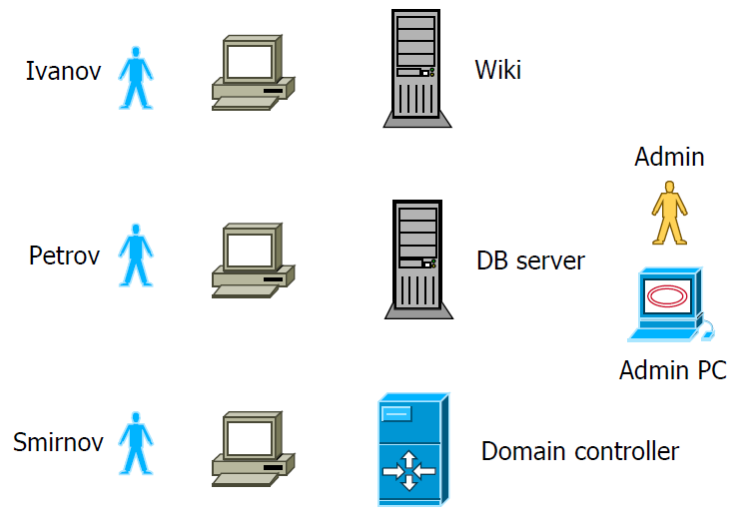
A testbed for preparing data to analytics - Architecture
Description of the network:
4 client computers
Domain controller
Wiki server
Database server
Users:
Ivanov
Petrov
Smirnov
Admin

Slide 5
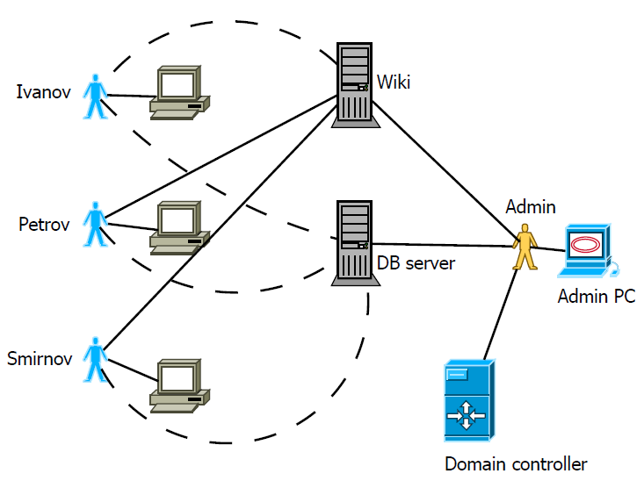
User behavior - Normal scenario

Slide 6
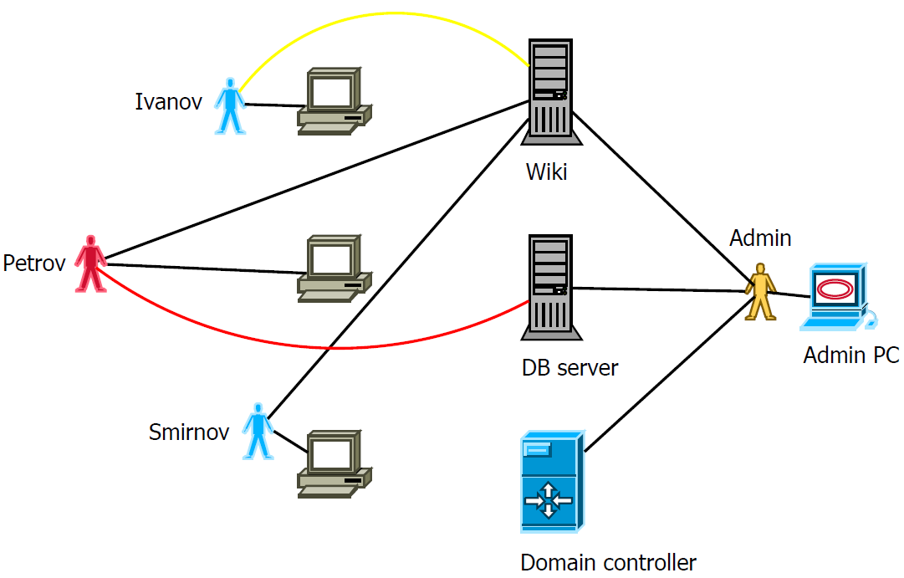
User behavior - Normal scenario

Slide 7
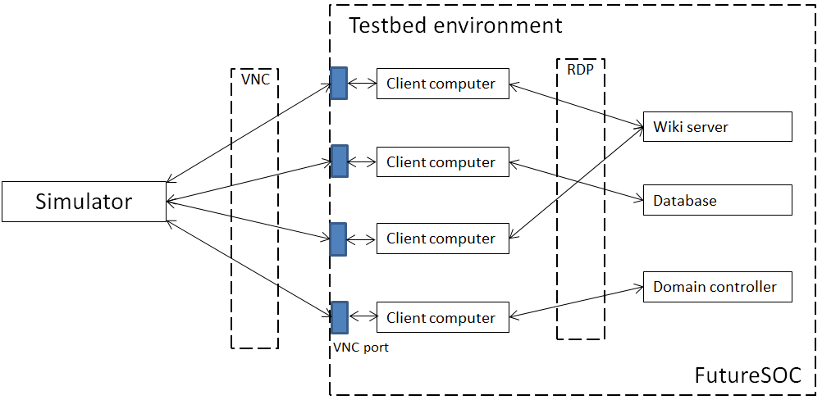
A testbed for preparing data to analytics - Implementation

Slide 8
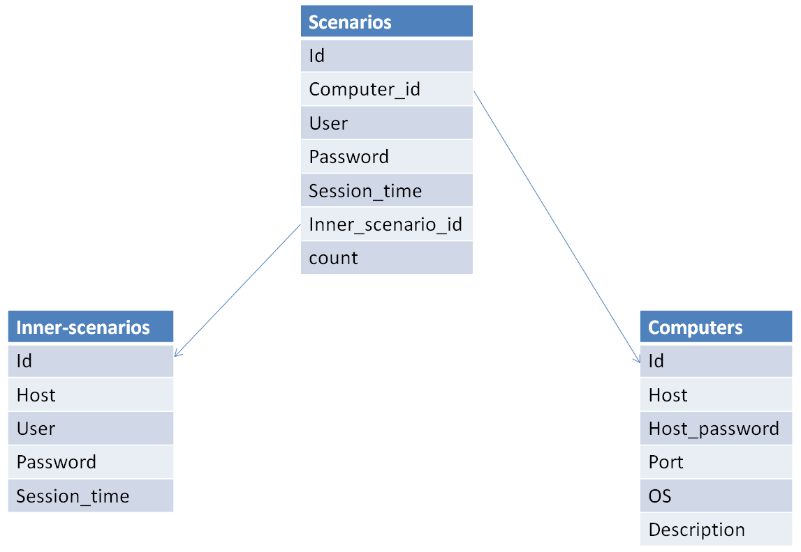
A testbed for preparing data to analytics - Implementation
FutureSOC ESXi server
VNC protocol
Python programming language
Vncdotool library
CSV

Slide 9
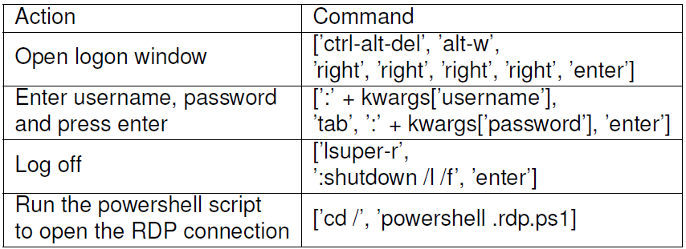
A testbed for preparing data to analytics - Implementation

Slide 10
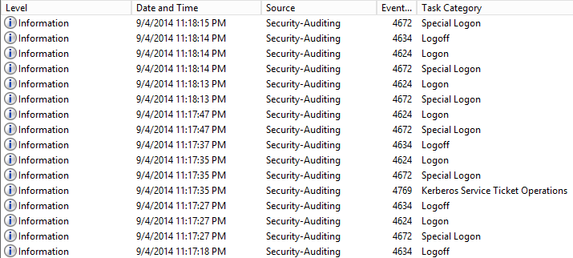
A testbed for preparing data to analytics - Results

Slide 11
Conclusion and Future Work
Experiment simulation with a test network of enterprise or campus level
Experiment simulation with large amount of users
Experiment simulation with random user behavior

Slide 12
Thank you for your attention!
Aragats Amirkhanyan
Internet-Technologies and Systems
Hasso Plattner Institute

